Slide 1
CREDIT EDA ASSIGNMENT
Submitted by - SATVIK PRAVEEN
Batch- DS C46 2022 July Batch

Slide 2
Problem Statement
The financial institution has provided two datasets which provides information on the current loan applications and the other provides information on previous loan applications.
The institution wishes to reduce the risk of loan default for the customers with no credit history and do not wish to miss out on the customers who are not going to default.
An analysis addressing the above problem is required.

Slide 3
Aim of EDA
How does the customer and loan attributes influence the tendency to default ?
Identification of patterns indicating the a client has difficulty paying their installments which may be used for taking actions such as denying the loan, reducing the amount of loan, lending (to risky applicants) at a higher rate of interest rate.
Identification of applicants capable of repaying the loan.
Driving factors behind loan defaults (variables which are strong indicators of default).

Slide 4
Assumptions made for the analysis
Threshold value of percentage of null values is 40%.
Days_Birth as well as Days_Employed can’t hold negative values.
Unknown and missing values can be converted to null values and can be given the null value treatment.

Slide 5
Plan and Approach - 1
application_data - The dataset is about new data.
Data Cleaning and understanding: Analysing outliers, understanding data types and dropping some unnecessary columns.
Univariate analysis: Analysing single feature
Categorical Variable: The features containing categories and nominal data.
Numerical Variable: The features containing numerical data
Target Column - Imbalance Ratio
Calculating the imbalance ratio using the Target column.

Slide 6
Plan and Approach - 2
Some Other derived metric : Calculating some features from the current features.
Segmented Univariate Analysis: The dataset is based on the target column which has two values.
Bivariate Analysis: Analysis between two variables
Multivariate Analysis: Heatmap to display the relationship between two variables.

Slide 7
Plan and Approach - 3
previous_data - contains the previous records.
data cleaning and understanding: understanding the features and knowing the data types of the columns, and dropping some unimportant columns.
Univariate Analysis: Analysing single column
Bivariate Analysis: Analysing two columns
Multivariate Analysis: Heatmaps to analyse multiple columns.

Slide 8
Application_data Dataset
There are 122 columns and 3,07,511 rows in the dataset.
We attempt to understand the datatypes of different columns. There are a lot of unnecessary columns which do not have an impact on the analysis. We would drop all such columns.
We are finally left with 26 columns, which is good enough for our analysis.

Slide 9
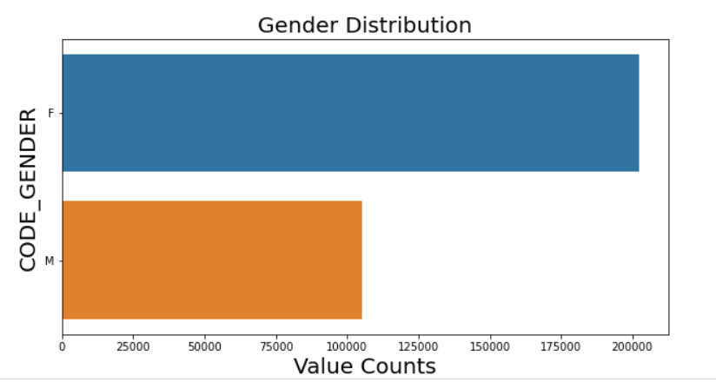

Slide 10
Observations
Females forms the majority of the clients who have applied for loans.
Males are almost half the population of females

Slide 11
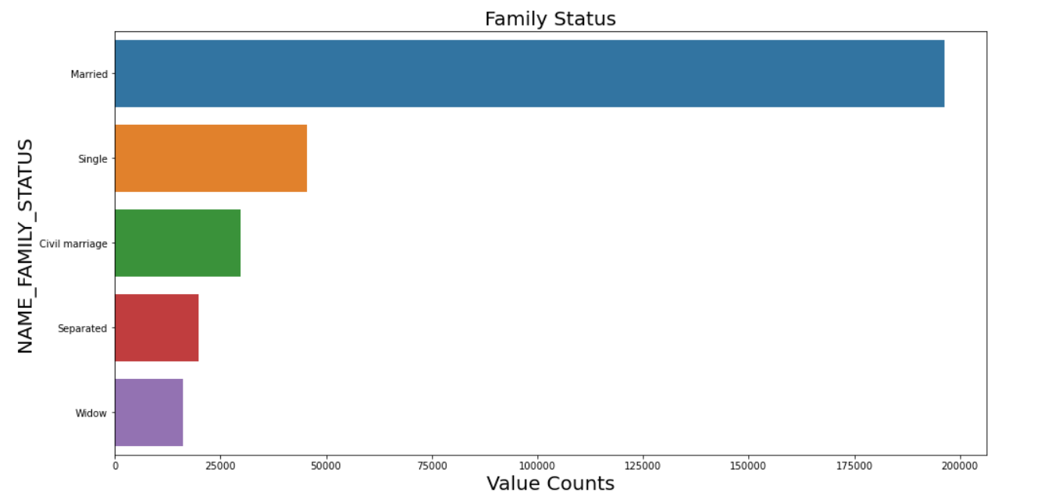

Slide 12
Observations
Majority of clients are Married.
Widow form the least composition of the population.

Slide 13
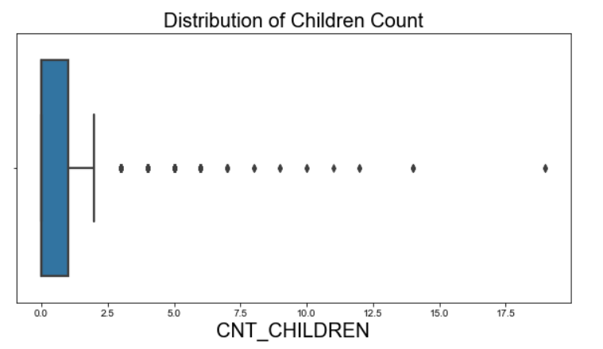

Slide 14
Observations
Most of the clients are having child.
A very tiny portion do not have any child.
There are some clear outliers in the dataset.
I suggest that the values above the 99.7th percentile should be capped with the 99.7th percentile values.

Slide 15
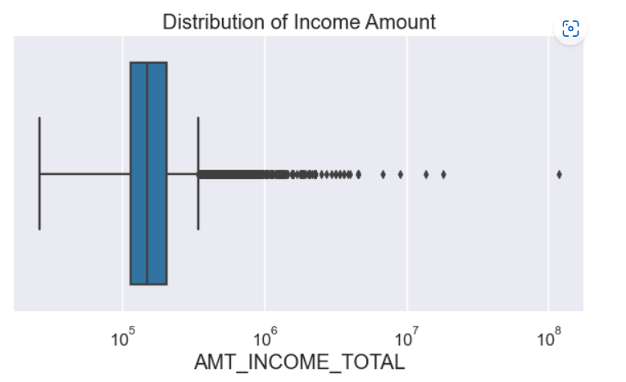

Slide 16
Observations
The data distribution clearly show that the body of the boxplot is very thin.
There are some outliers in the data. Although most outliers are acceptable.
I suggest that the values above the 97th percentile level should be dropped.

Slide 17
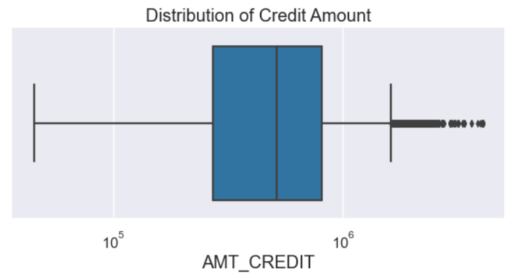

Slide 18
Observations
The columns clearly contains some data points which can be considered as outliers. However, as clearly evident from the analysis. The data points are gradually increasing with some exceptions towards the end.
The values above 99.95th percentile are clear outliers
These endpoints should be dropped out of the analysis.

Slide 19
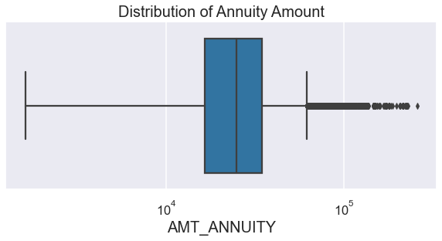

Slide 20
Observations
Most client have annuity amount in the first quantile.
The column contains outliers which are clearly evident. However, there are many outliers which are increasingly uniformly and hence, should be made part of the analysis.
However, the data above 99th percentile shoots to a high value.
I therefore, suggest to drop these outliers.

Slide 21
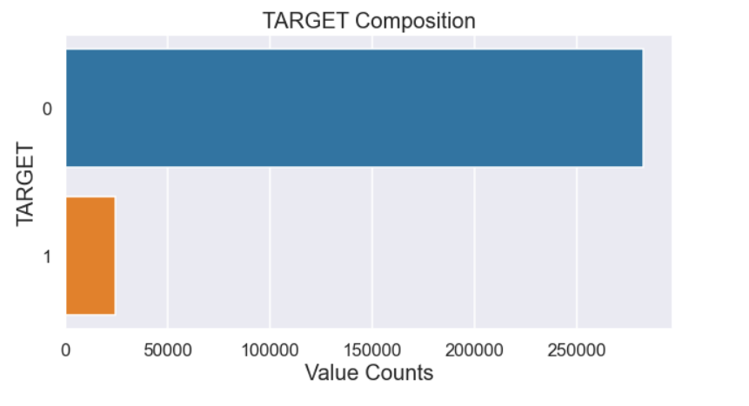

Slide 22
Observation and Imbalance ratio
Most of the clients belong to the Target 0 category.
Imbalance ratio is 11.39.

Slide 23
Segmented Analysis
We will divide the dataset based on the Target column. The target column has two values 0 and 1.
We define a new dataframe Target_0_df with the Target Column value as 0.
We define a new dataframe Target_1_df with the Target Column value as 1.

Slide 24
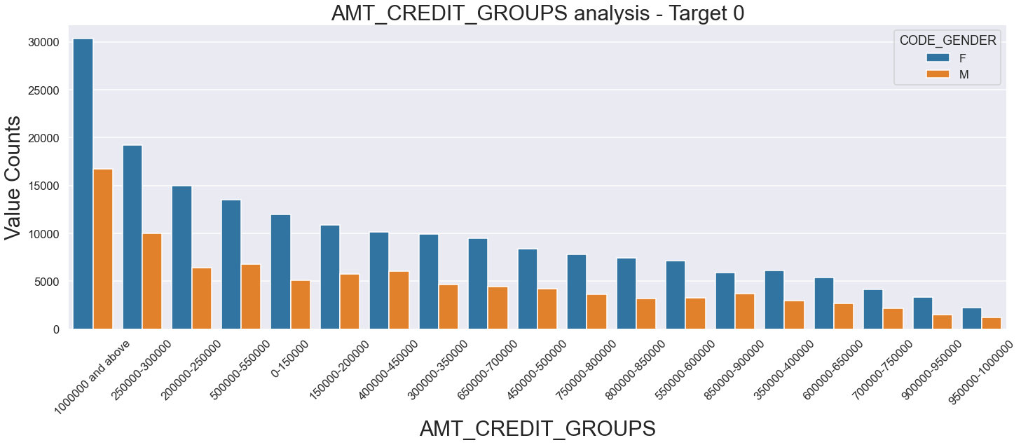

Slide 25
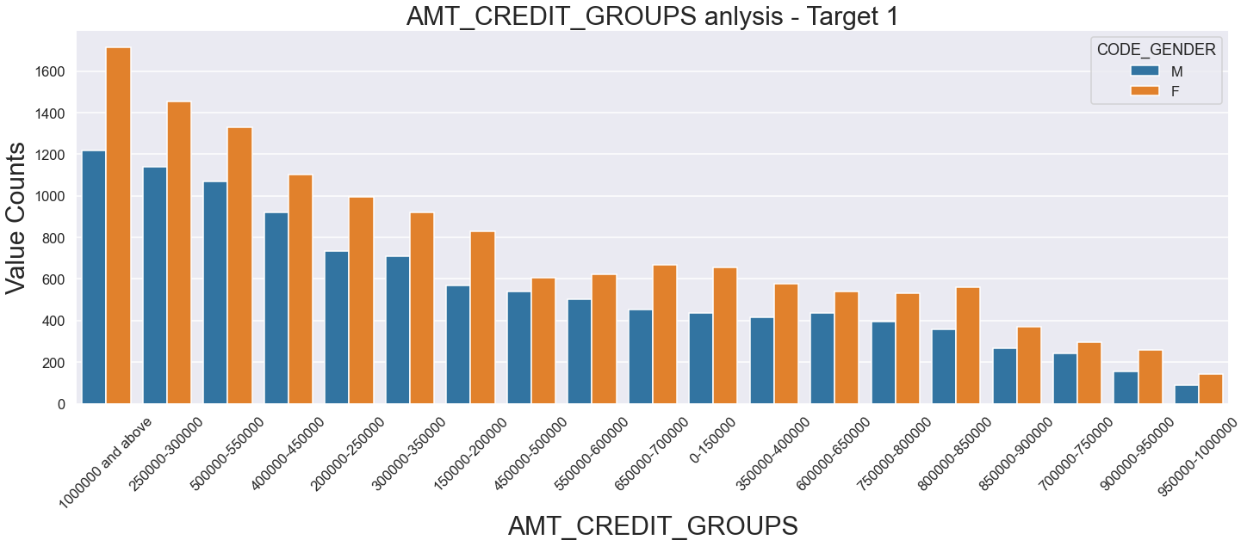

Slide 26
Observations
Number of Females is higher than the number of males.
The levels between 100000 and 200000 have more credits.
For most categories, females are dominant.
Very few belong to the 450000 to 500000 categories.

Slide 27
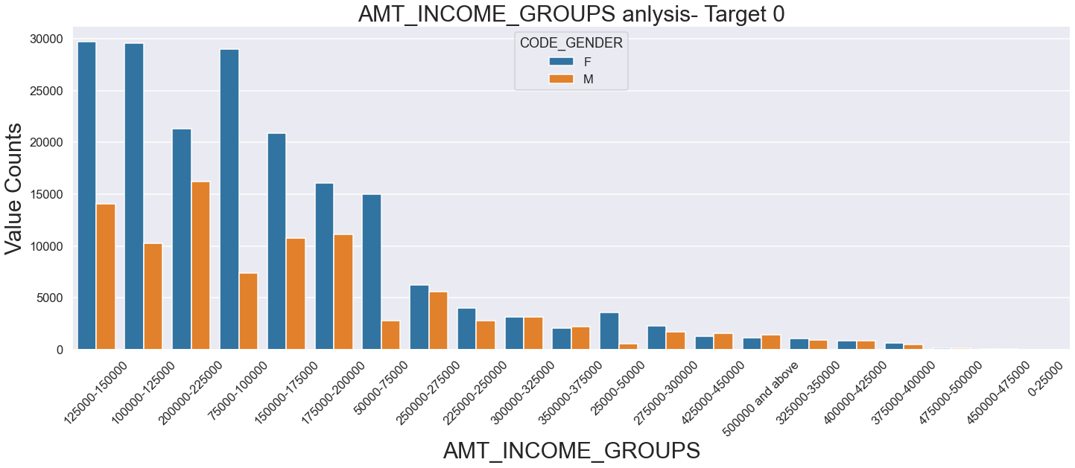

Slide 28
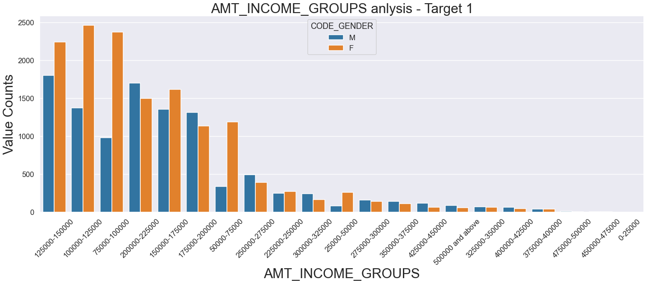

Slide 29
Observations
Number of females higher than the number of males.
For most categories, females are dominant.
Target = 0:
Females highest in 100000 - 125000
Males highest in 200000 - 225000
Target = 1:
Females highest in 125000 - 150000
Males highest in 125000 - 250000

Slide 30
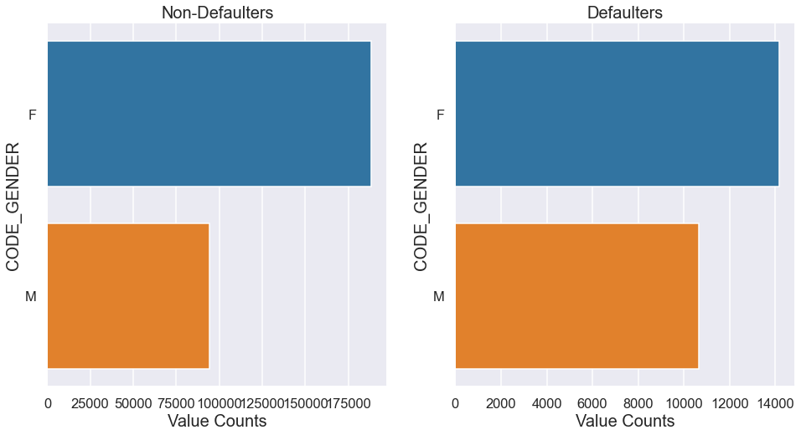

Slide 31
Observations
In both the categories, Females dominate.
However, the proportion of males in the defaulters category increased significantly in comparison to the non-defaulter category. This suggests that males are likely to default more than females.

Slide 32
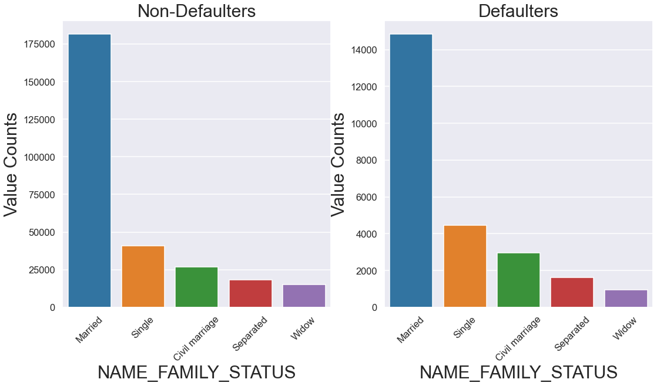

Slide 33
Observations
The married people are more likely to apply for loans.
However, the marital status is not a very reliable factor for deciding on the defaulters.

Slide 34
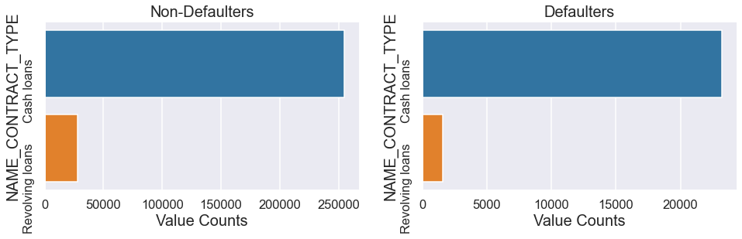

Slide 35
Observations
In both the categories, Cash loans dominates.
However, the percentage composition of Revolving loans in Defaulters is less as compared to its composition in the non-defaulters. This suggests that Revolving loan applicants are less likely to default.

Slide 36
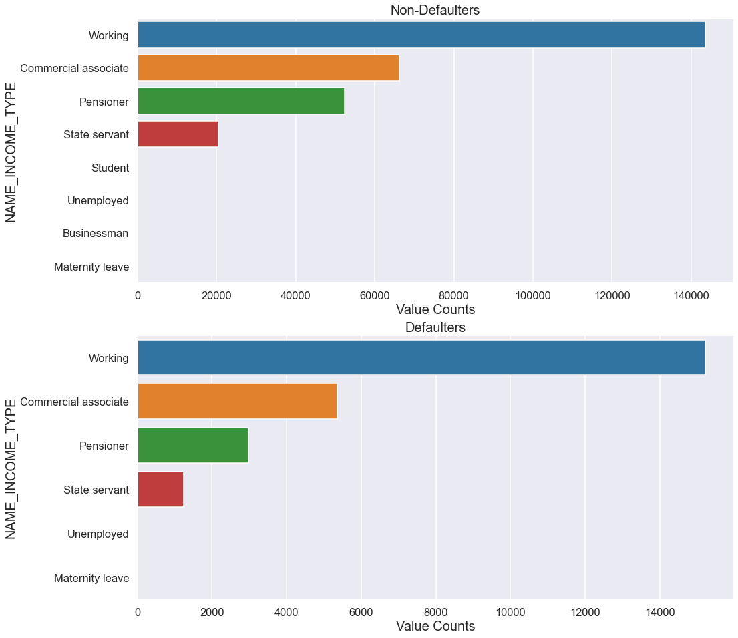

Slide 37
Observations
The defaulter and non-defaulter group both consist of the income types: Working, Commercial associate, Pensioner, State servant, Unemployed and Maternity leave
None of the defaulters are Businessman or Student.

Slide 38
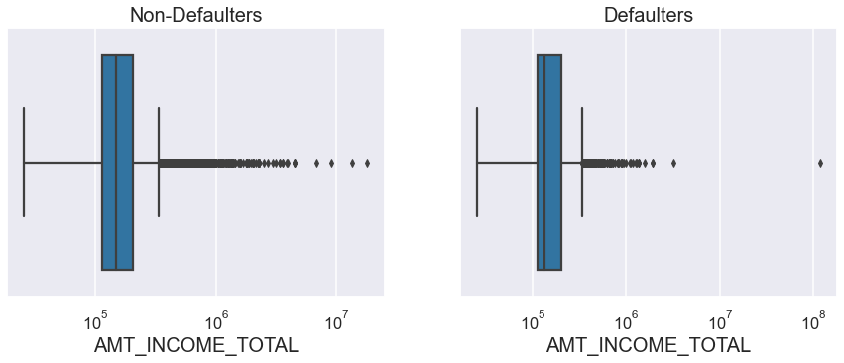

Slide 39
Observations
There are some outliers for both the Defaulters and non-Defaulters category.
There are fewer defaulters who lie in the second quantile.

Slide 40
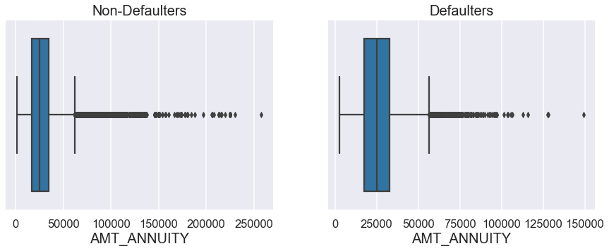

Slide 41
Observations
Both the plots have some outliers.
The Defaulters category have higher number of clients in the 4th quantile.

Slide 42
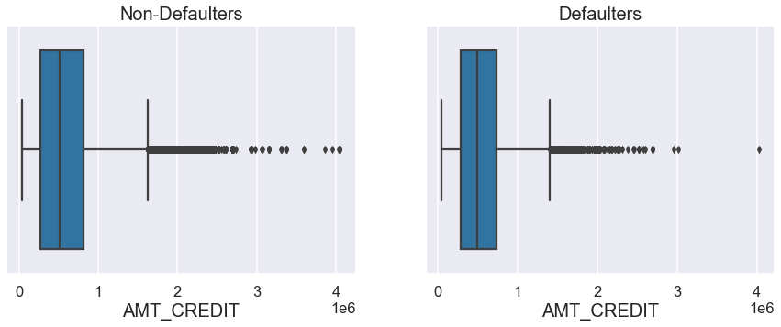

Slide 43
Observations
There are some outliers which are presented in both the plots.
The third quantile is larger for the Non-Defaulters.
Both the categories have maximum clients in the fourth quantile.

Slide 44
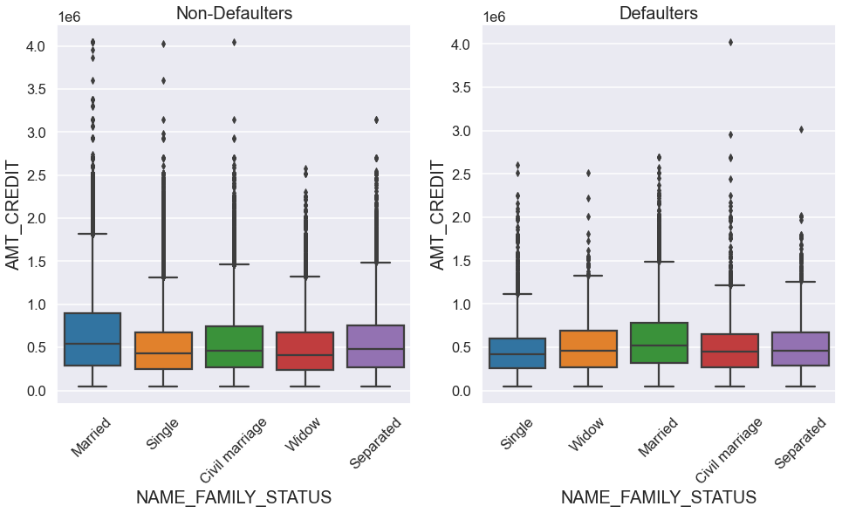

Slide 45
Observation
Both the plots show similar kinds of distribution.
Married people have the highest credit in both the categories.
In Non-Defaulters category, the married, single, and civil marriage sub-categories have more outliers.
In Defaulters category, the civil marriage and separated sub-categories have more outliers.

Slide 46
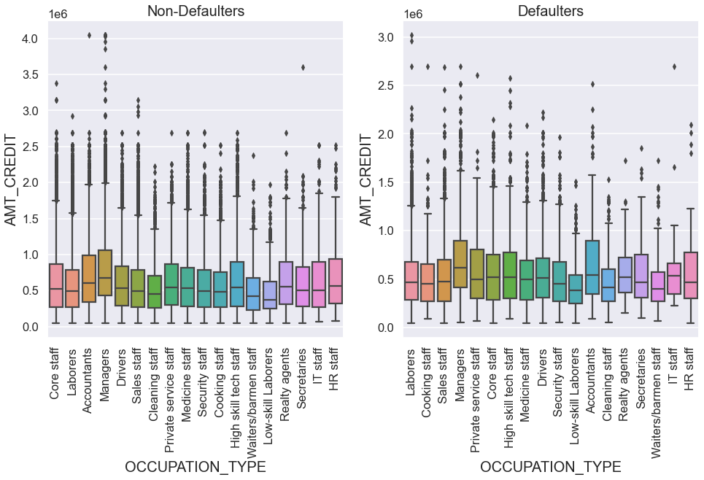

Slide 47
Observations
The maximum amount of credit in case of non-defaulters for most of the categories is higher than the maximum amount of credit in the case of defaulters.
There are some outliers in both the cases.
Most of the credits are in the third quantile in both the cases.

Slide 48
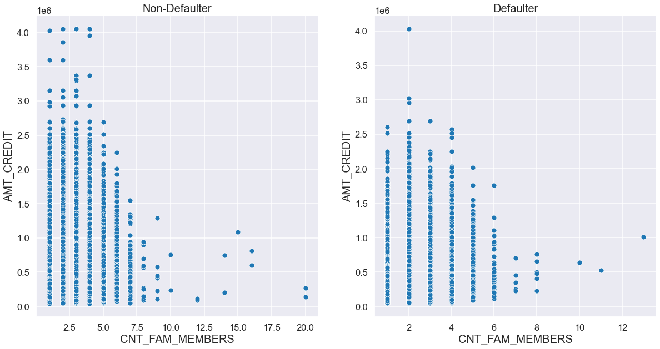

Slide 49
Observations
The client is equally likely to default if the family is small and credit amount is low.
Clients with larger families and high credit amount default less frequently.

Slide 50
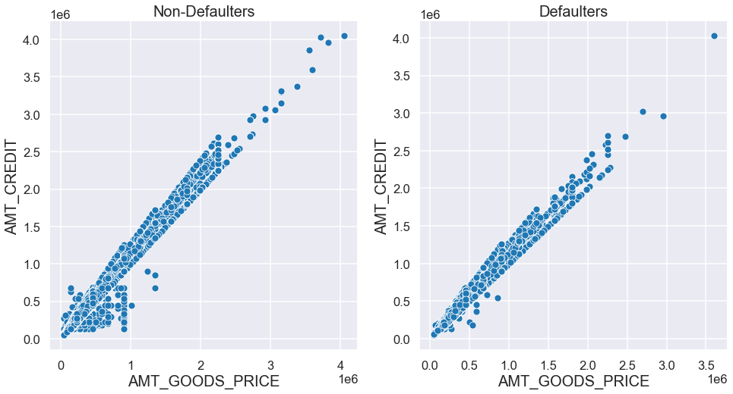

Slide 51
Observations
There is a positive correlation between the amount of credit and the amount of goods price in both the cases.

Slide 52
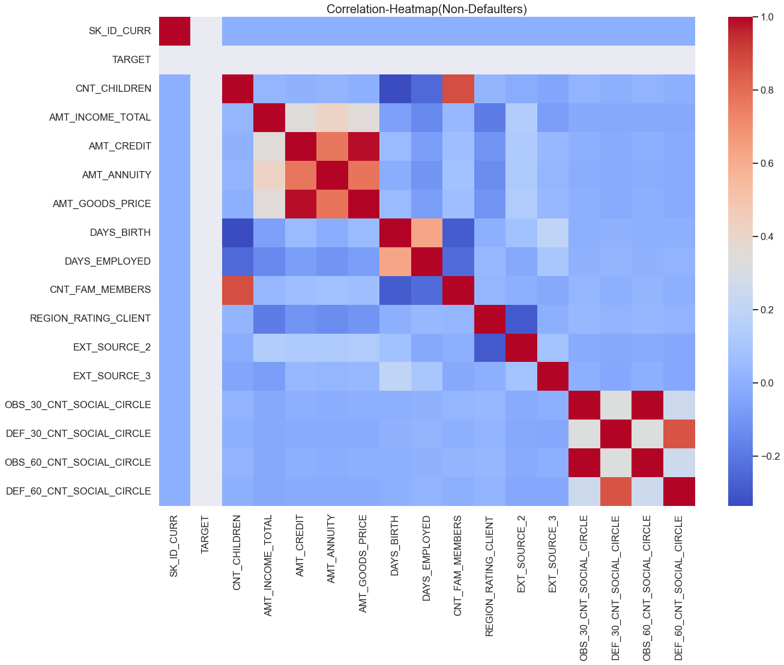

Slide 53
Observations
AMT_CREDIT & AMT_ANNUITY are positively correlated.
EXT_SOURCE_2 & REGION_RATING_CLIENT are negatively correlated.
REGION_RATING_CLIENT & INCOME_TOTAL are negatively correlated.

Slide 54
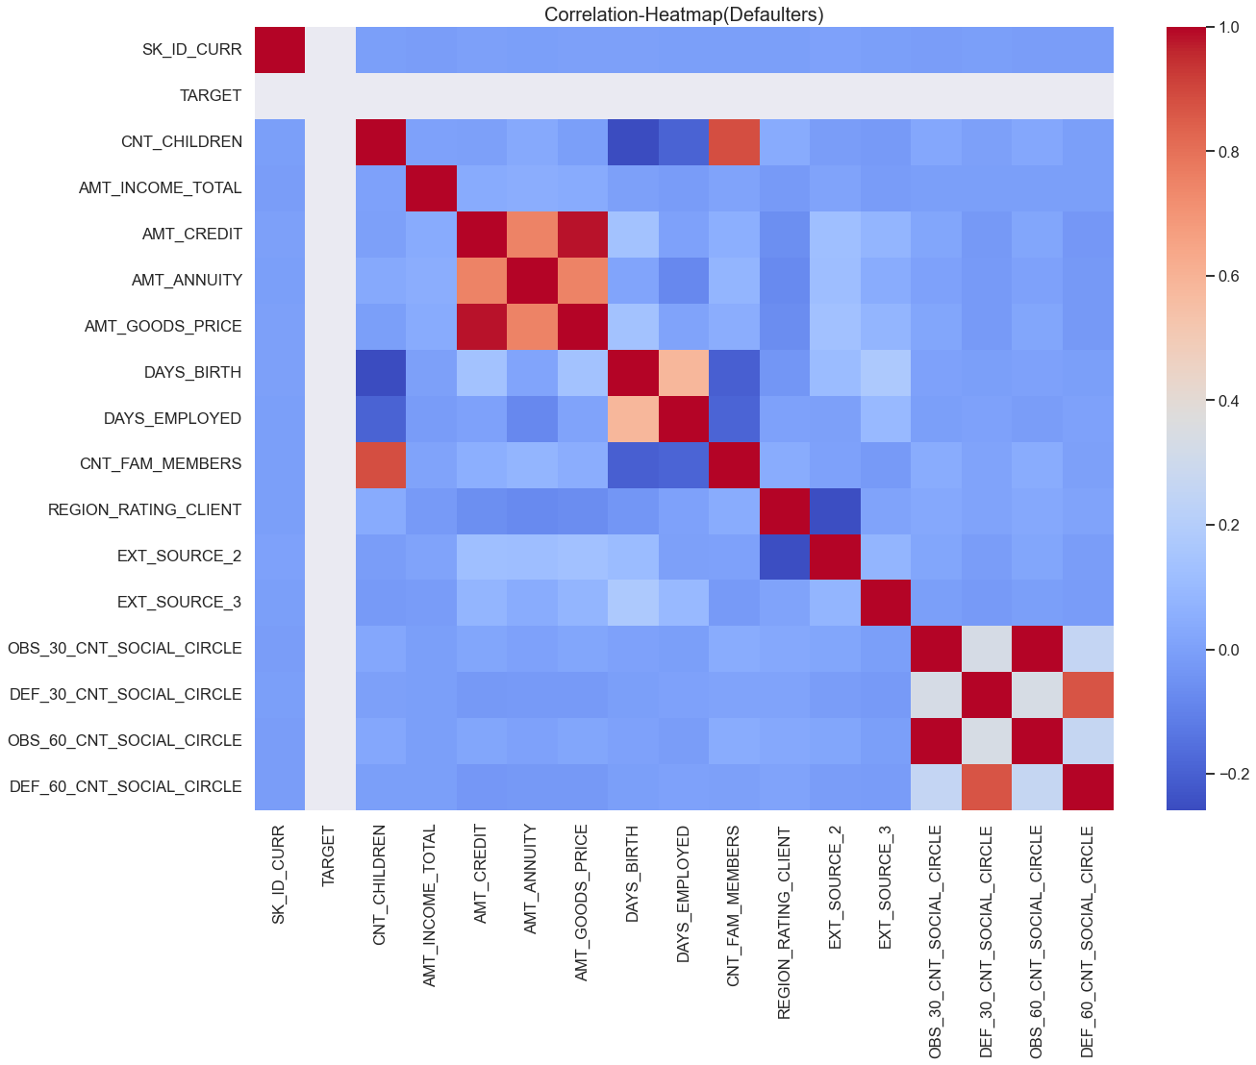

Slide 55
Observations
AMT_CREDIT & AMT_ANNUITY are positively correlated.
EXT_SOURCE_2 & REGION_RATING_CLIENT are negatively correlated.
REGION_RATING_CLIENT & INCOME_TOTAL are negatively correlated.

Slide 56
Previous Application Dataset
The dataset contains 37 columns and 16,70,214 rows.
There are many columns which do not have much impact on our analysis and therefore, we shall drop them.
This will remove 18 columns at the end of the process and we would be left with 19 columns.
We then move on perform univariate and bivariate analysis.

Slide 57
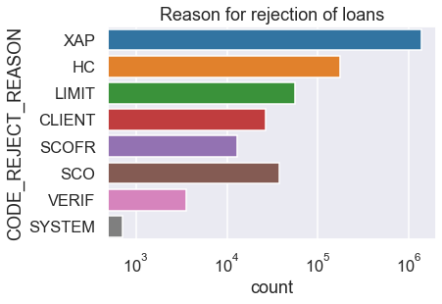

Slide 58
Observations
Most rejections have taken place in the XAP category, followed by Historical Cost.
The least rejections have been done by the system.

Slide 59
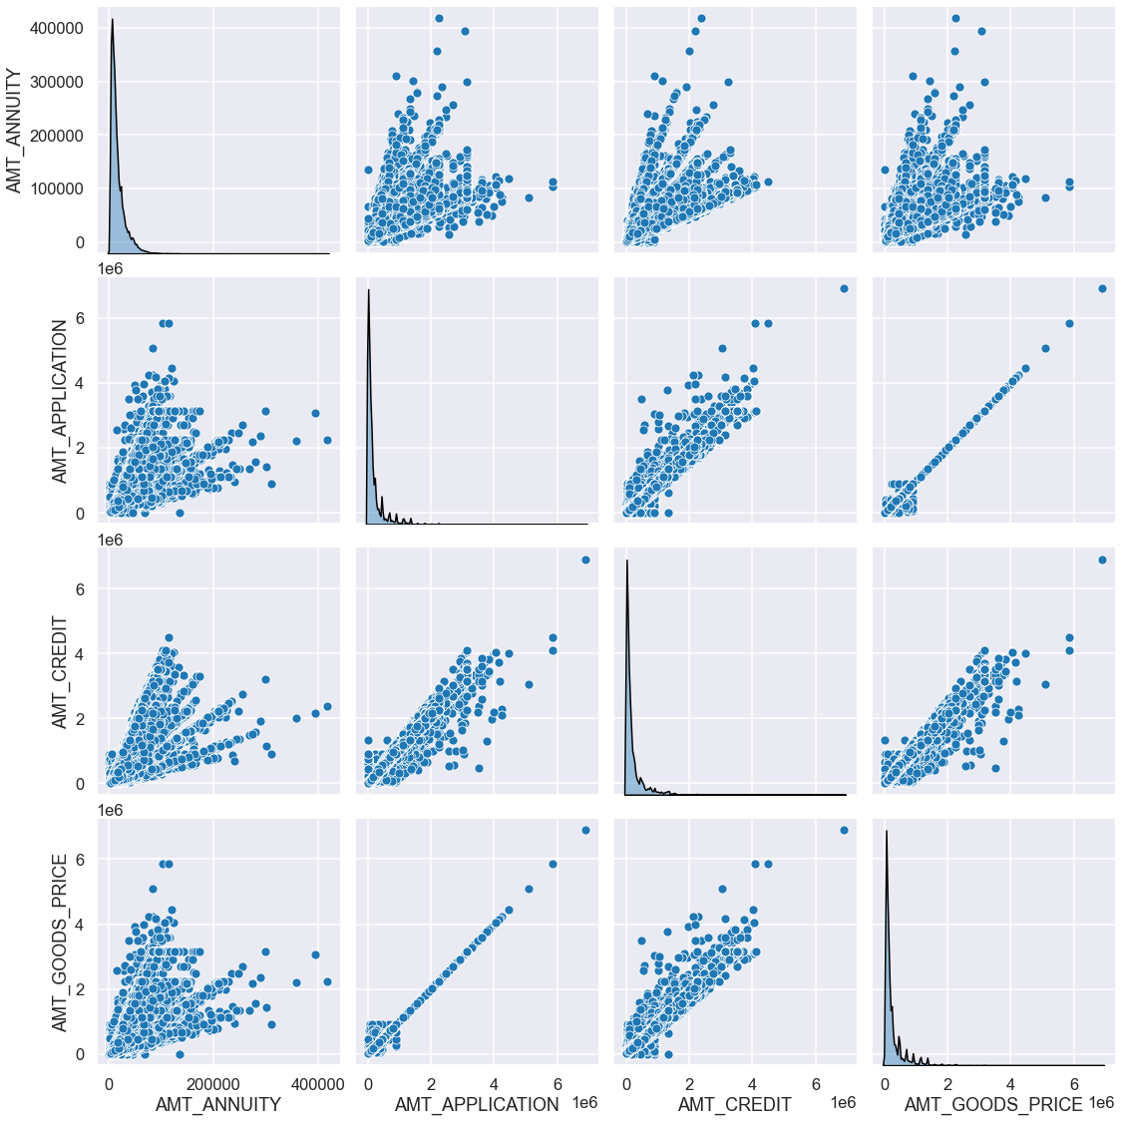
Pairplot between the numerical columns

Slide 60
Observations
There is a high positive correlation between the Application amount and the Goods price amount.
Annuity has a positive impact on the Goods price, credit amount.

Slide 61
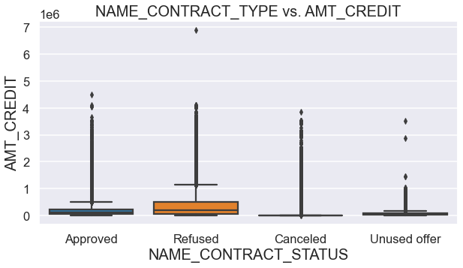

Slide 62
Observation
When the amount credit is low, either, the contract gets cancelled or the contract becomes an unused offer.

Slide 63
Merging the two dataset
Performing the merging between application_data and previous_data.
I prefer to use left join to perform the merge. This will preserve the records from the application_data and would select those rows which have common records from the previous_data.
The column used for merging is “SK_ID_CURR”. This is common to both the dataset.

Slide 64
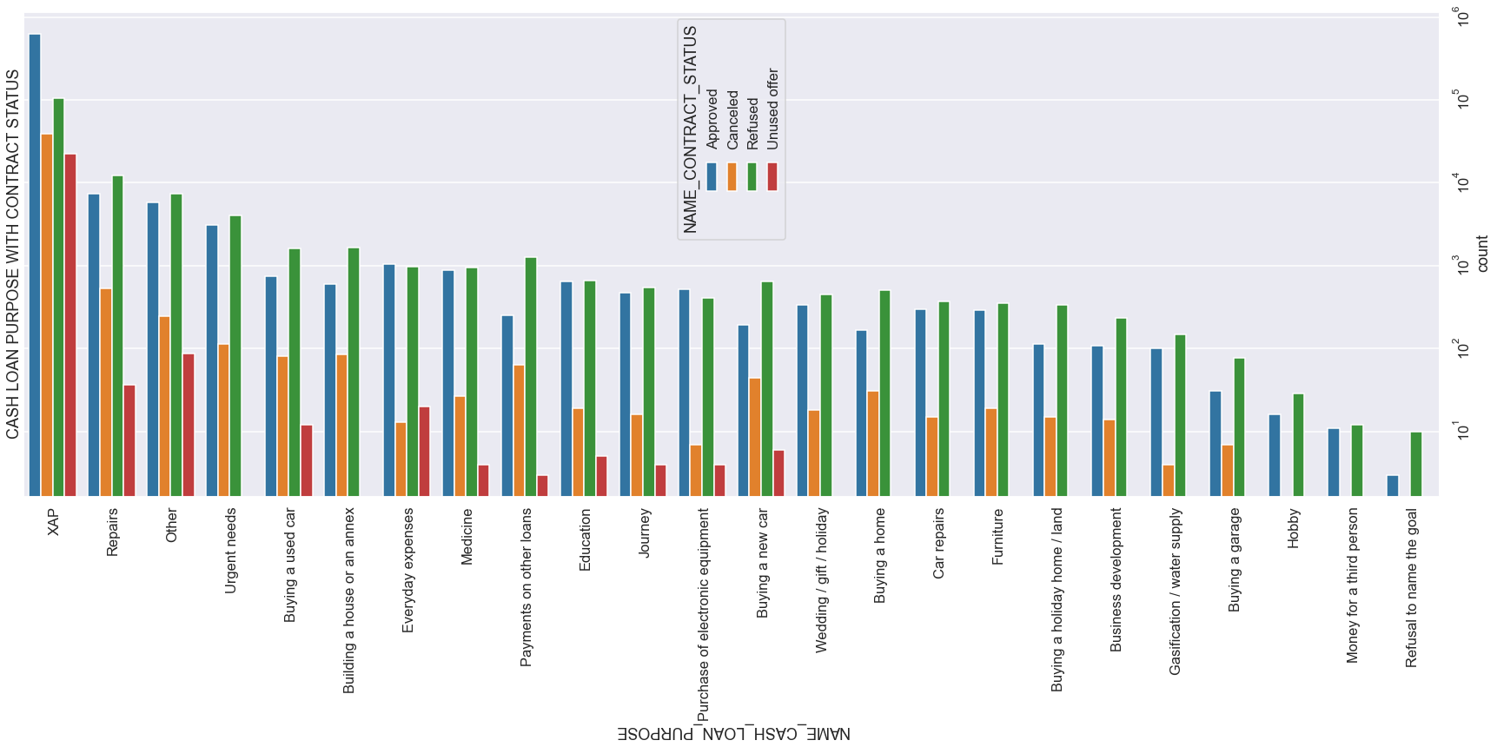

Slide 65
Observations
XAP category has the highest number of approved loans.
There are no cancelled loans in case of Hobby, money for a third person category and refusal to name the goal category. Further, in these categories there are more refused loans than approved loans.

Slide 66
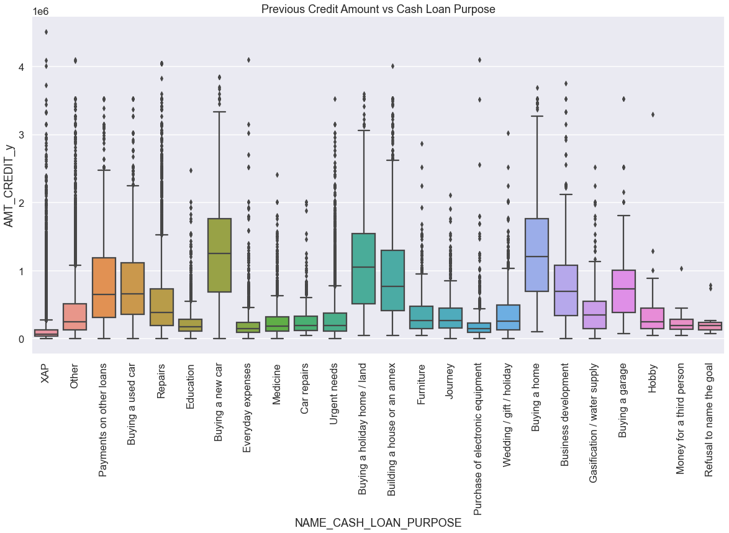

Slide 67
Observations
'Buying a home','Buying a land','Buying a new car' and 'Building a house' have higher credit amount.
Money for third person or a Hobby is having less applied for.

Slide 68
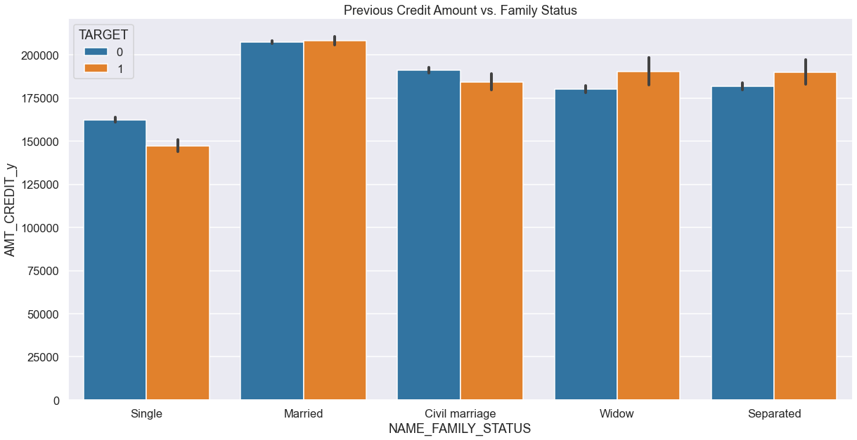

Slide 69
Observations
Married people apply for higher credit amount in case of Target 0 as well as Target 1.
For the categories of Single and Civil marriage, the credit amount is higher in case of Target 0 than Target 1. Banks can focus more on them.
For the categories of Widow and Separated, the credit amount is higher in case of Target 1 than Target 0. Banks should focus in a limited manner on them.

Slide 70
Final Recommendations
‘Student’ ,’pensioner’ and ‘Businessman’ in general should be focussed more.
Banks should focus less on the working income type as they have more unsuccessful payments.
Widows and Separated with higher credit amount are likely to default.
Those family guys should be contacted more who have a large family size and are seeking high credit amount as they are less likely to default.
Banks should avoid giving cash loan for XAP purpose.

